Slide 1
Customer Behaviour Analysis and Prediction
Customer Behaviour Analysis and Prediction
- Sudharshan Paindi jayakumar

Slide 2
Preprocessing for Exploratory Analysis
“engagement_report.log” has been converted to usable values and stored in “company_log_title.csv”
Column “Company Type” has been converted to one-hot encoding and stored in “company_log_title.csv”
Column “subscribed_after_free_trial” has been converted from bool to binary values and stored in “company_log_title.csv”
Logging count were only available for 7 days. So, trial period has been assumed to be 7 days in our case.

Slide 3
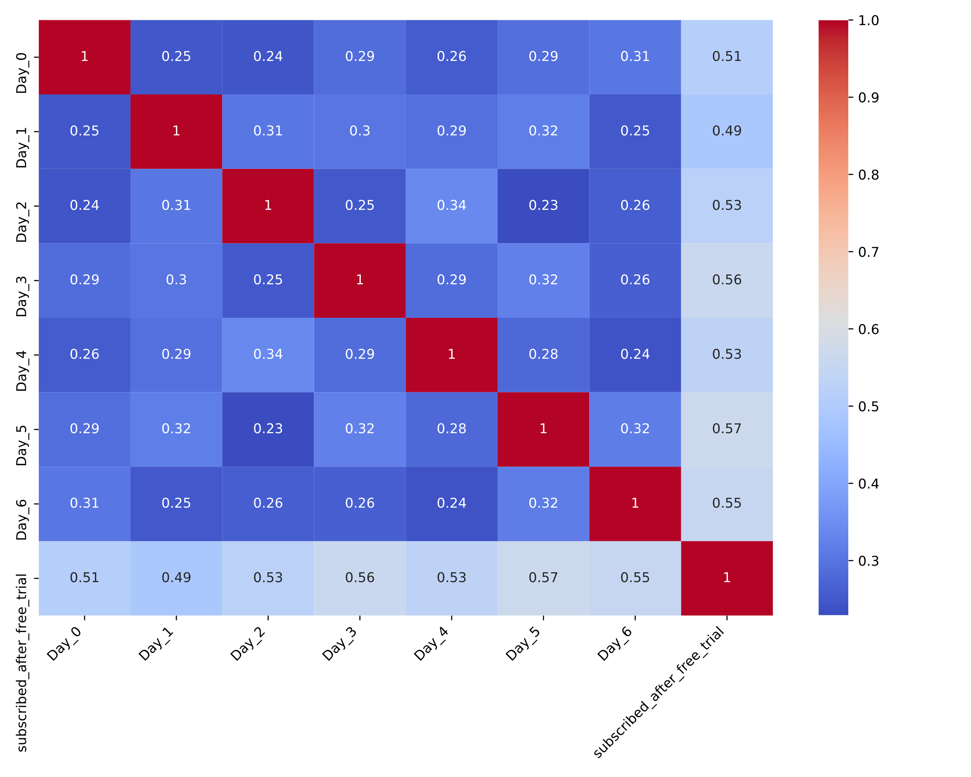
Research Questions
1. Is there a correlation (between the day visits) and/or (between the day visits & whether customers have subscribed or not)?
From the correlation plot on the right side, it can be seen that the Pearson Correlation between the day visits (Day_0, Day_1….Day_6) are quite low (0.20-0.40) and therefore there is no strong evidence to conclude based on these.
The correlation between the day visits & subscribed_after_trial is medium and relatively-slightly higher for (Day_5 & subscribed_after_trial). So, there is relatively higher chance that the customers who visited on Day_5 would subscribe.

Slide 4
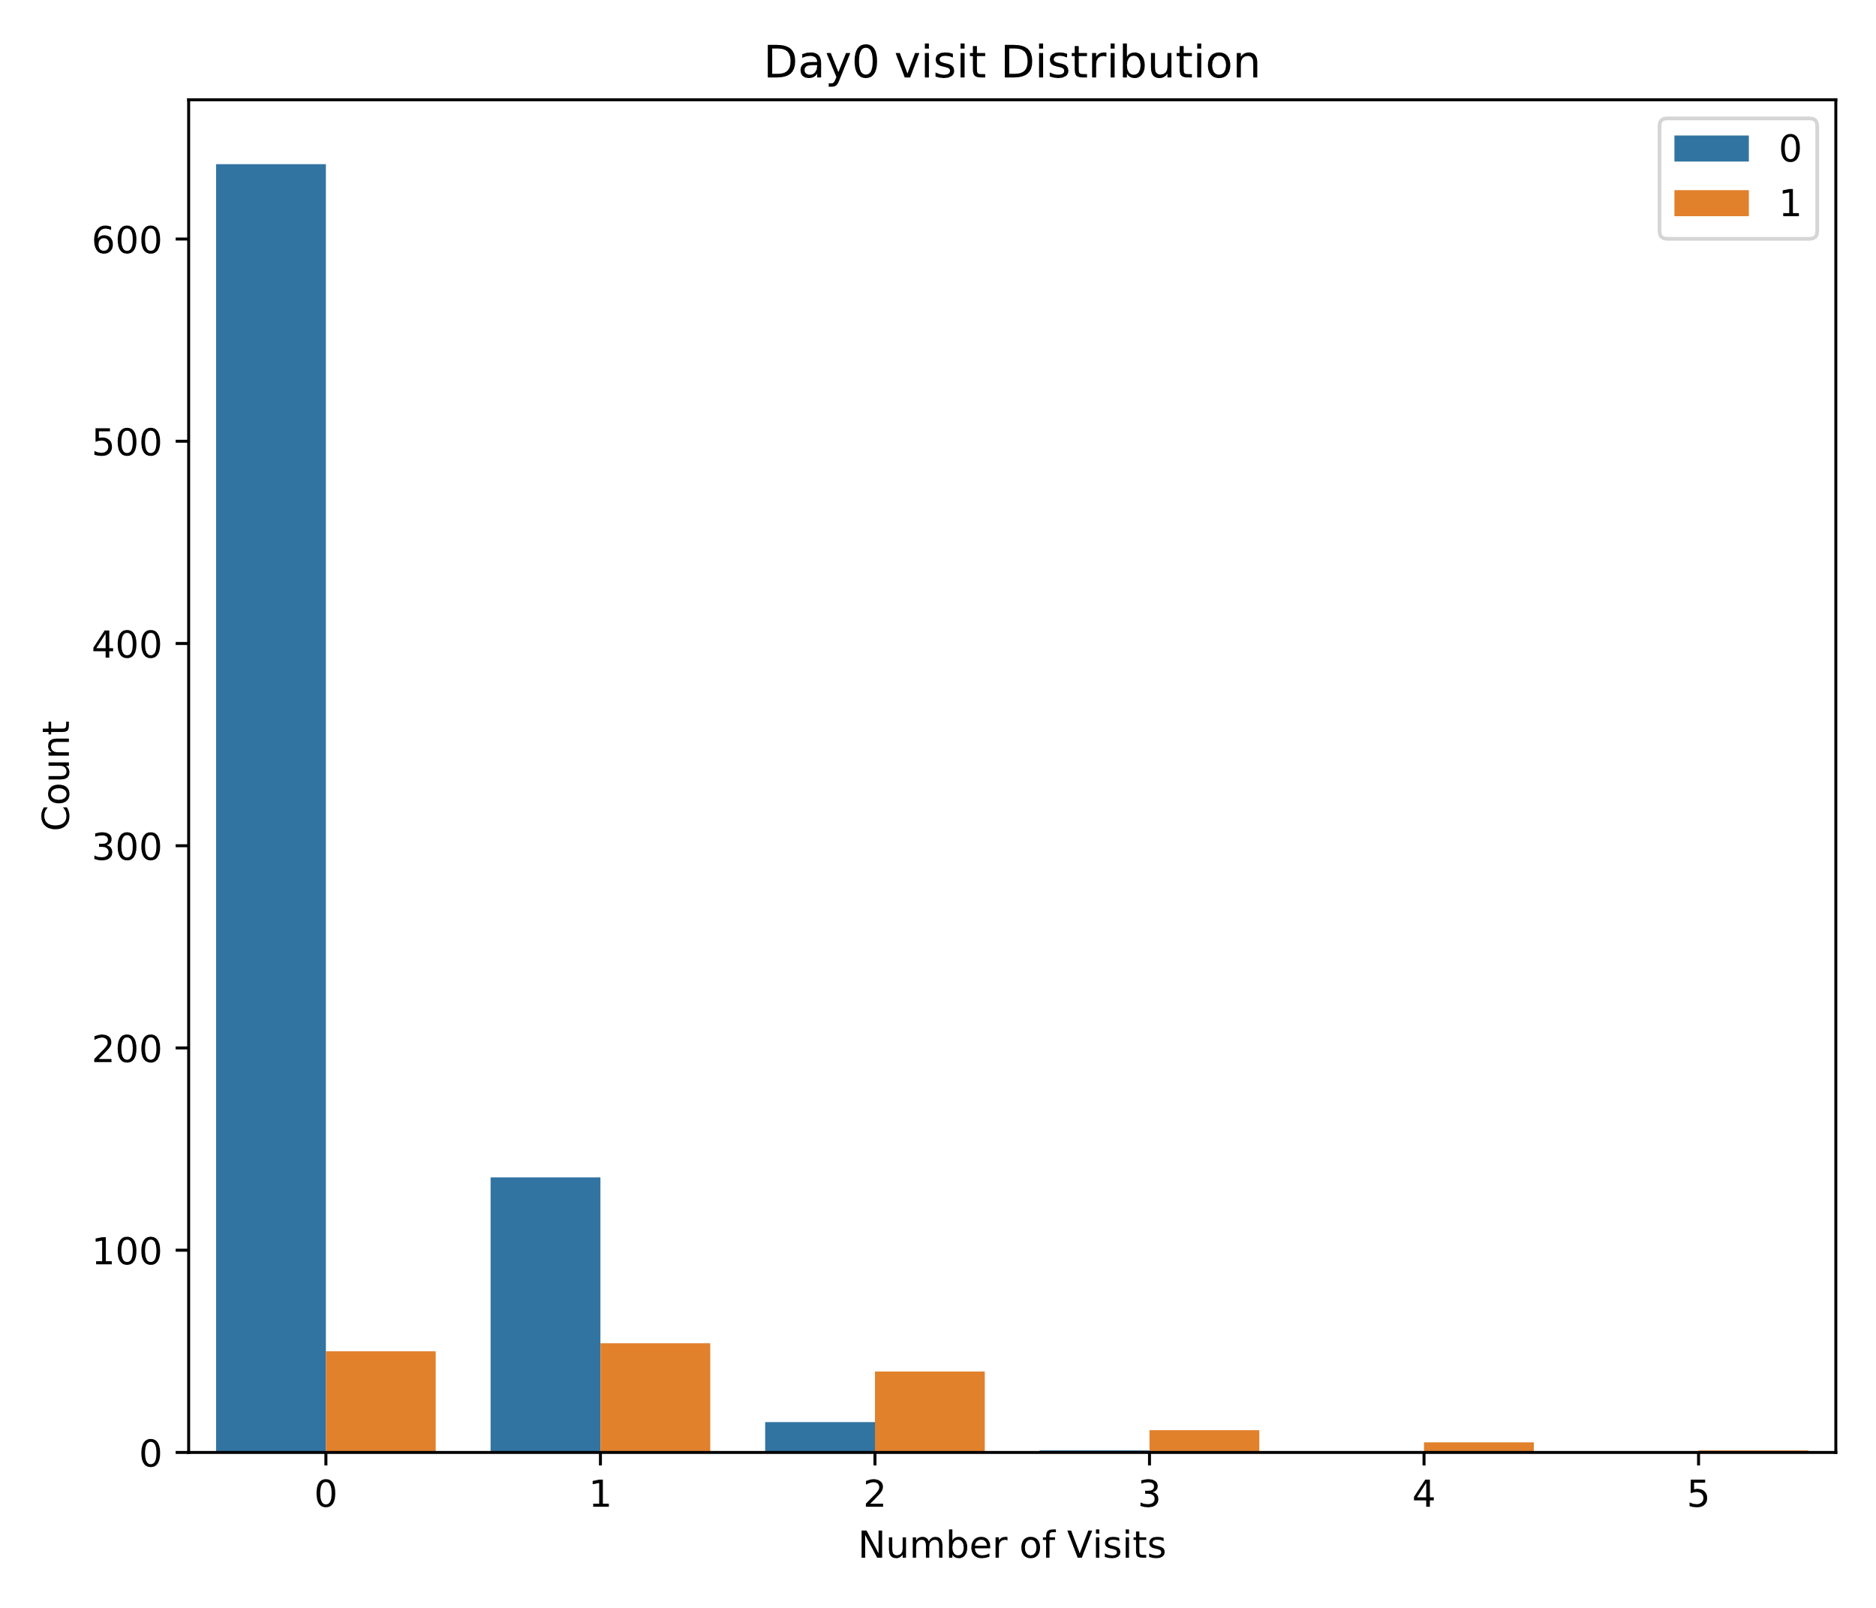
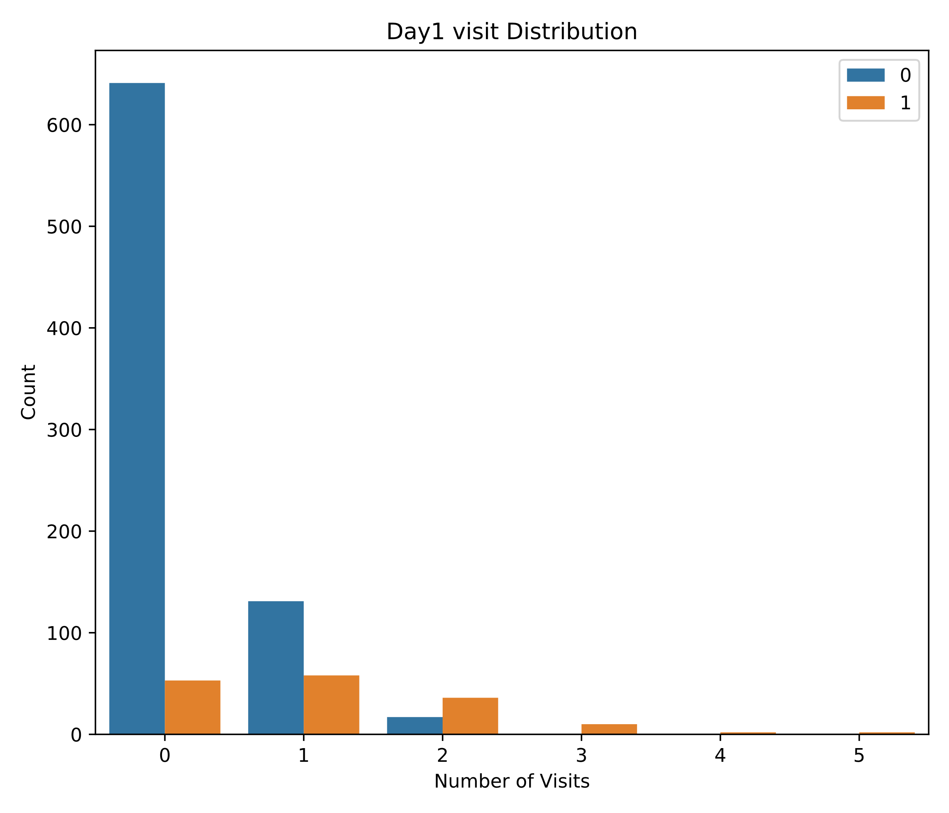
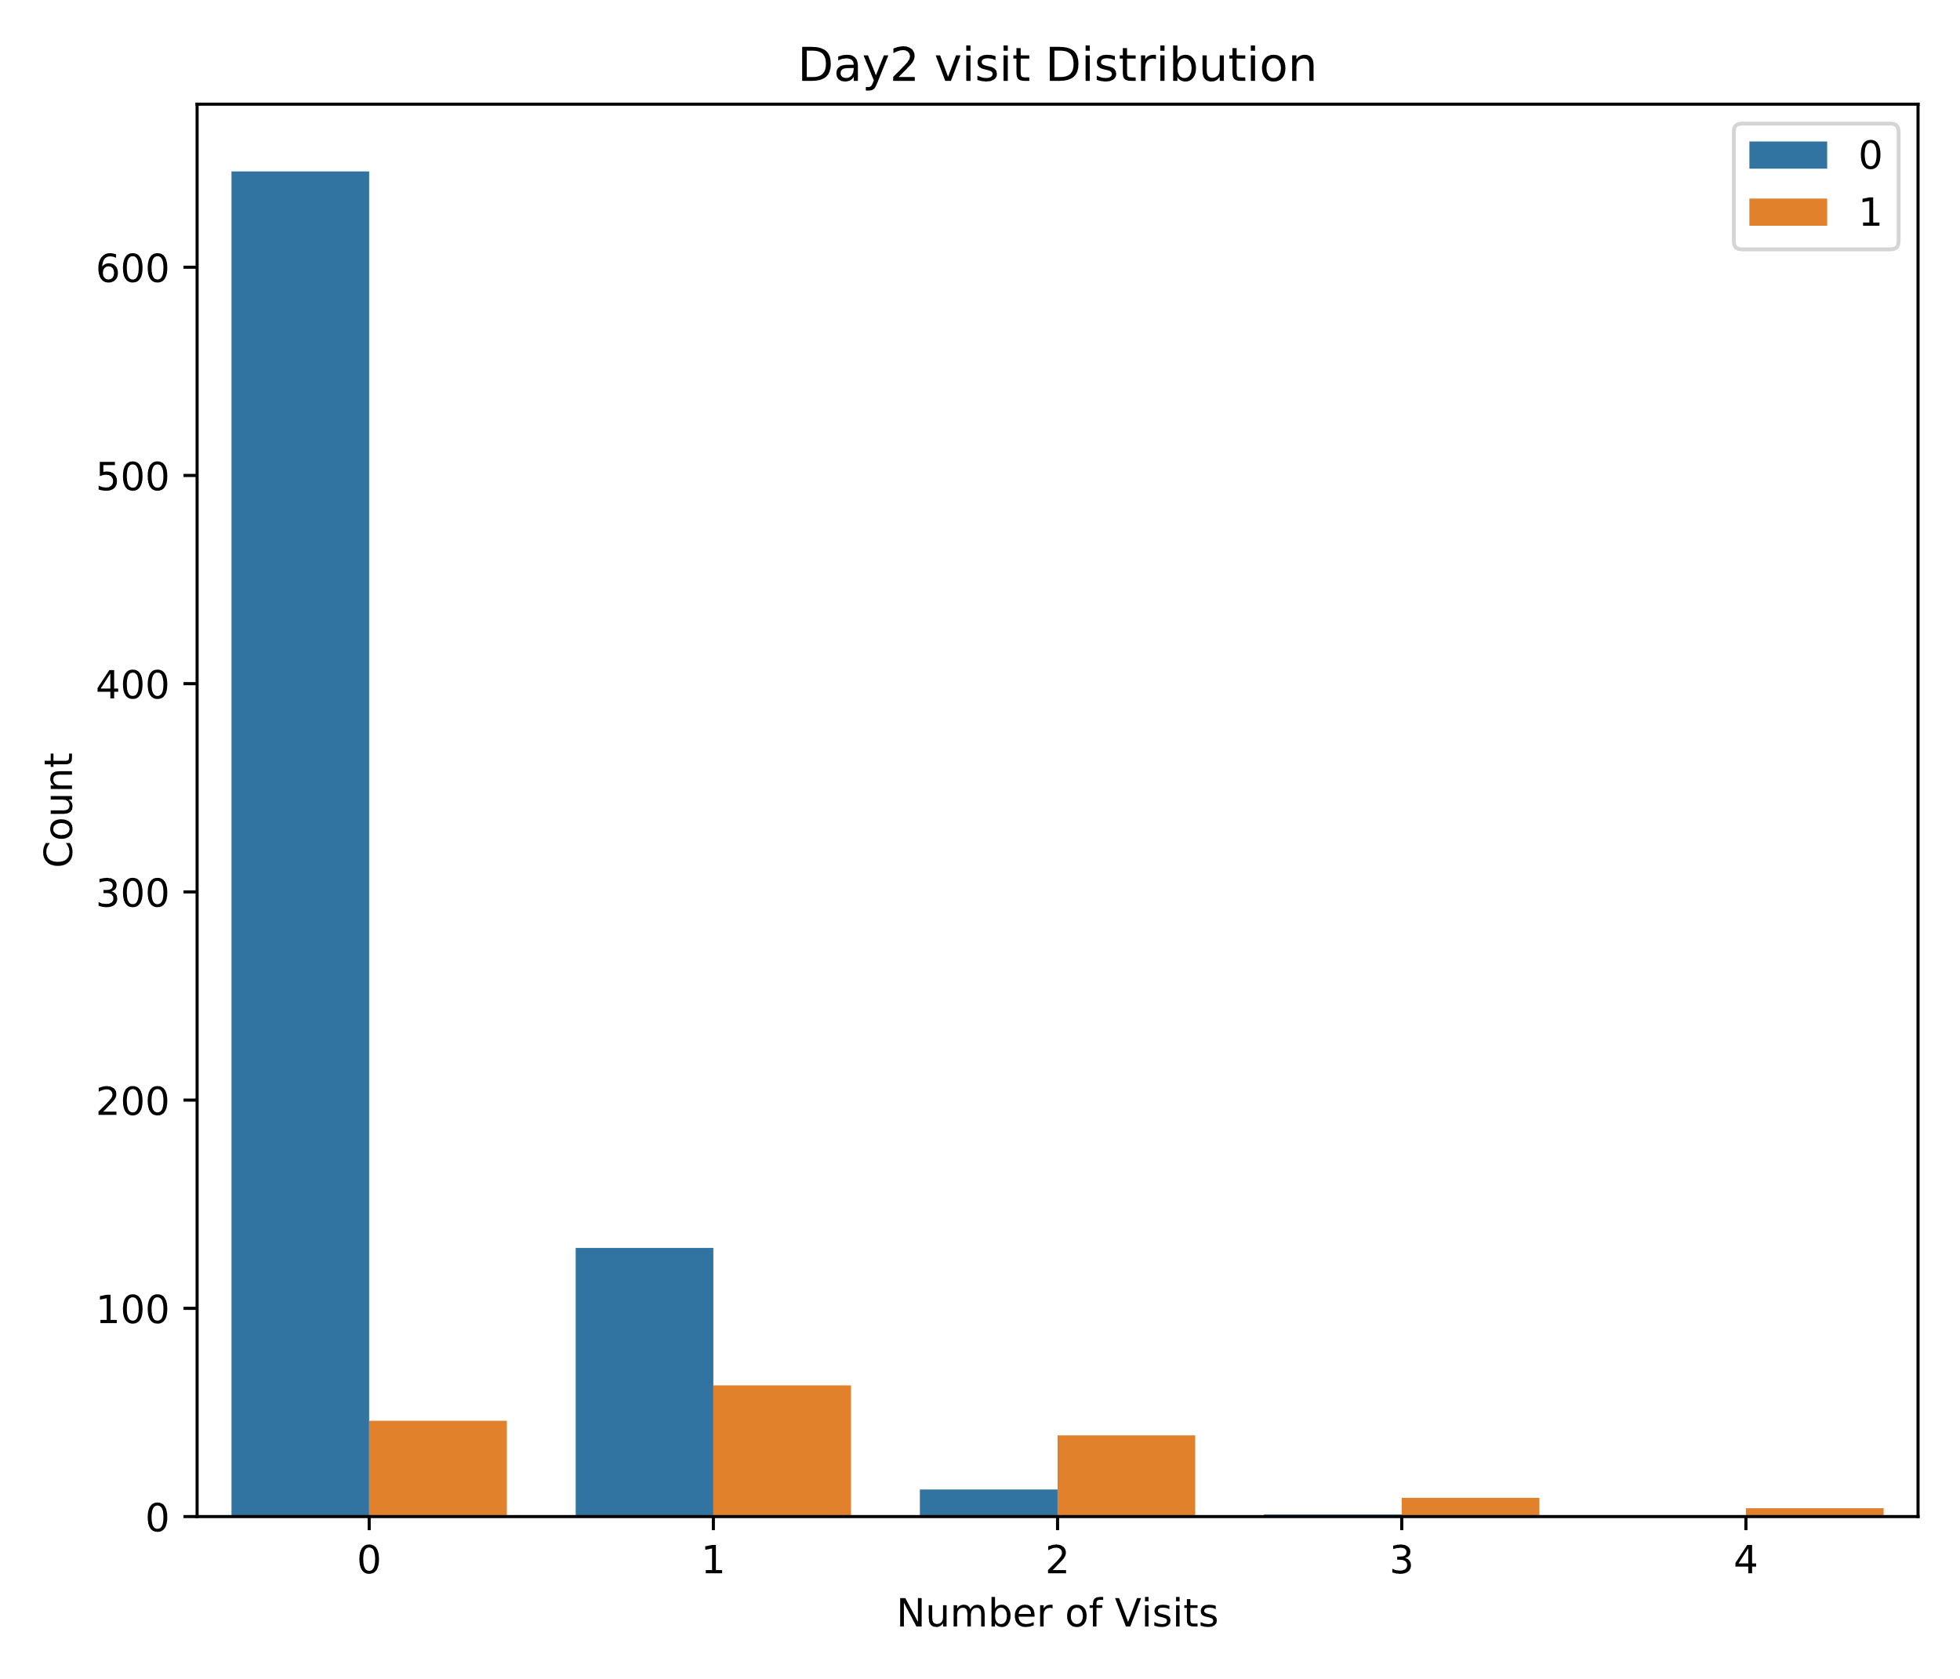
Research Questions (Contd.)
2. Do the customers who are likely to subscribe visit more often compared to the customers who aren’t likely to subscribe?
0 -> Not Subscribed ; 1 -> Subscribed after free trial period

Slide 5
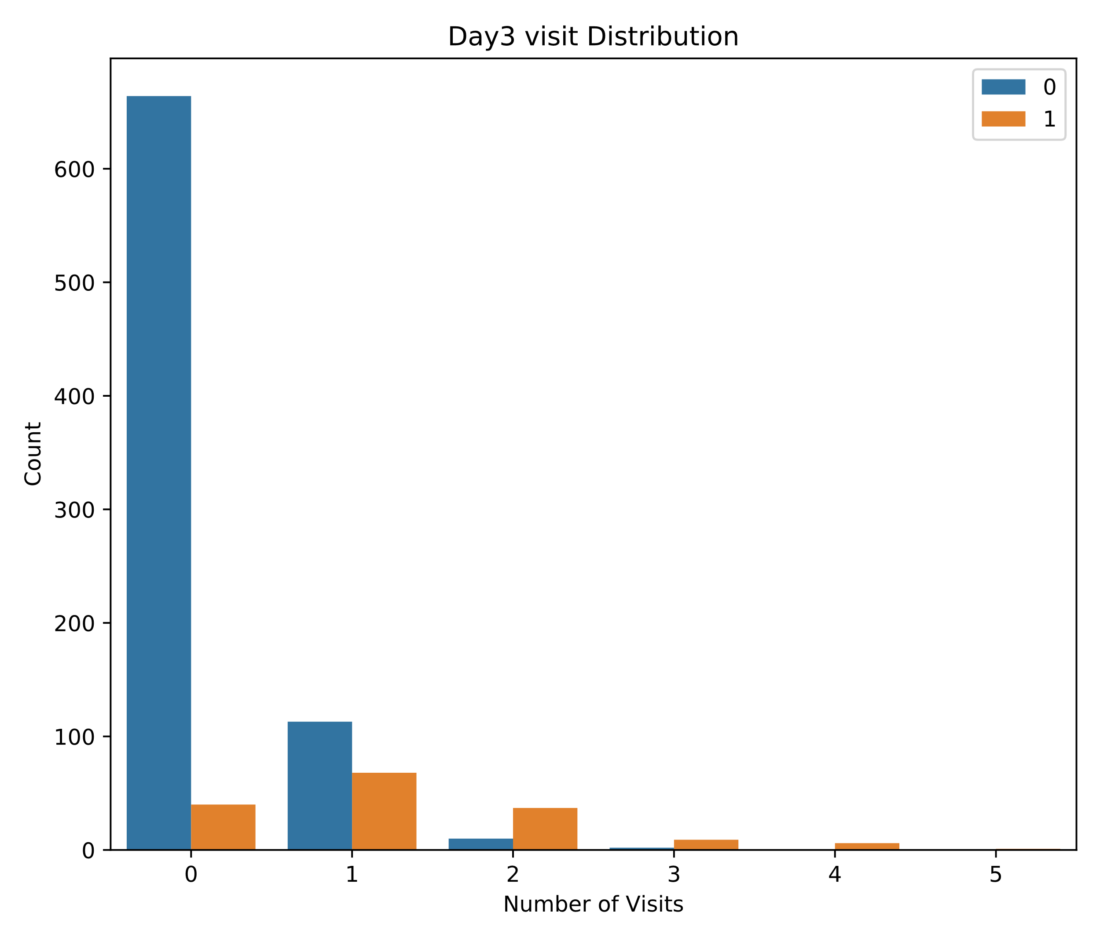
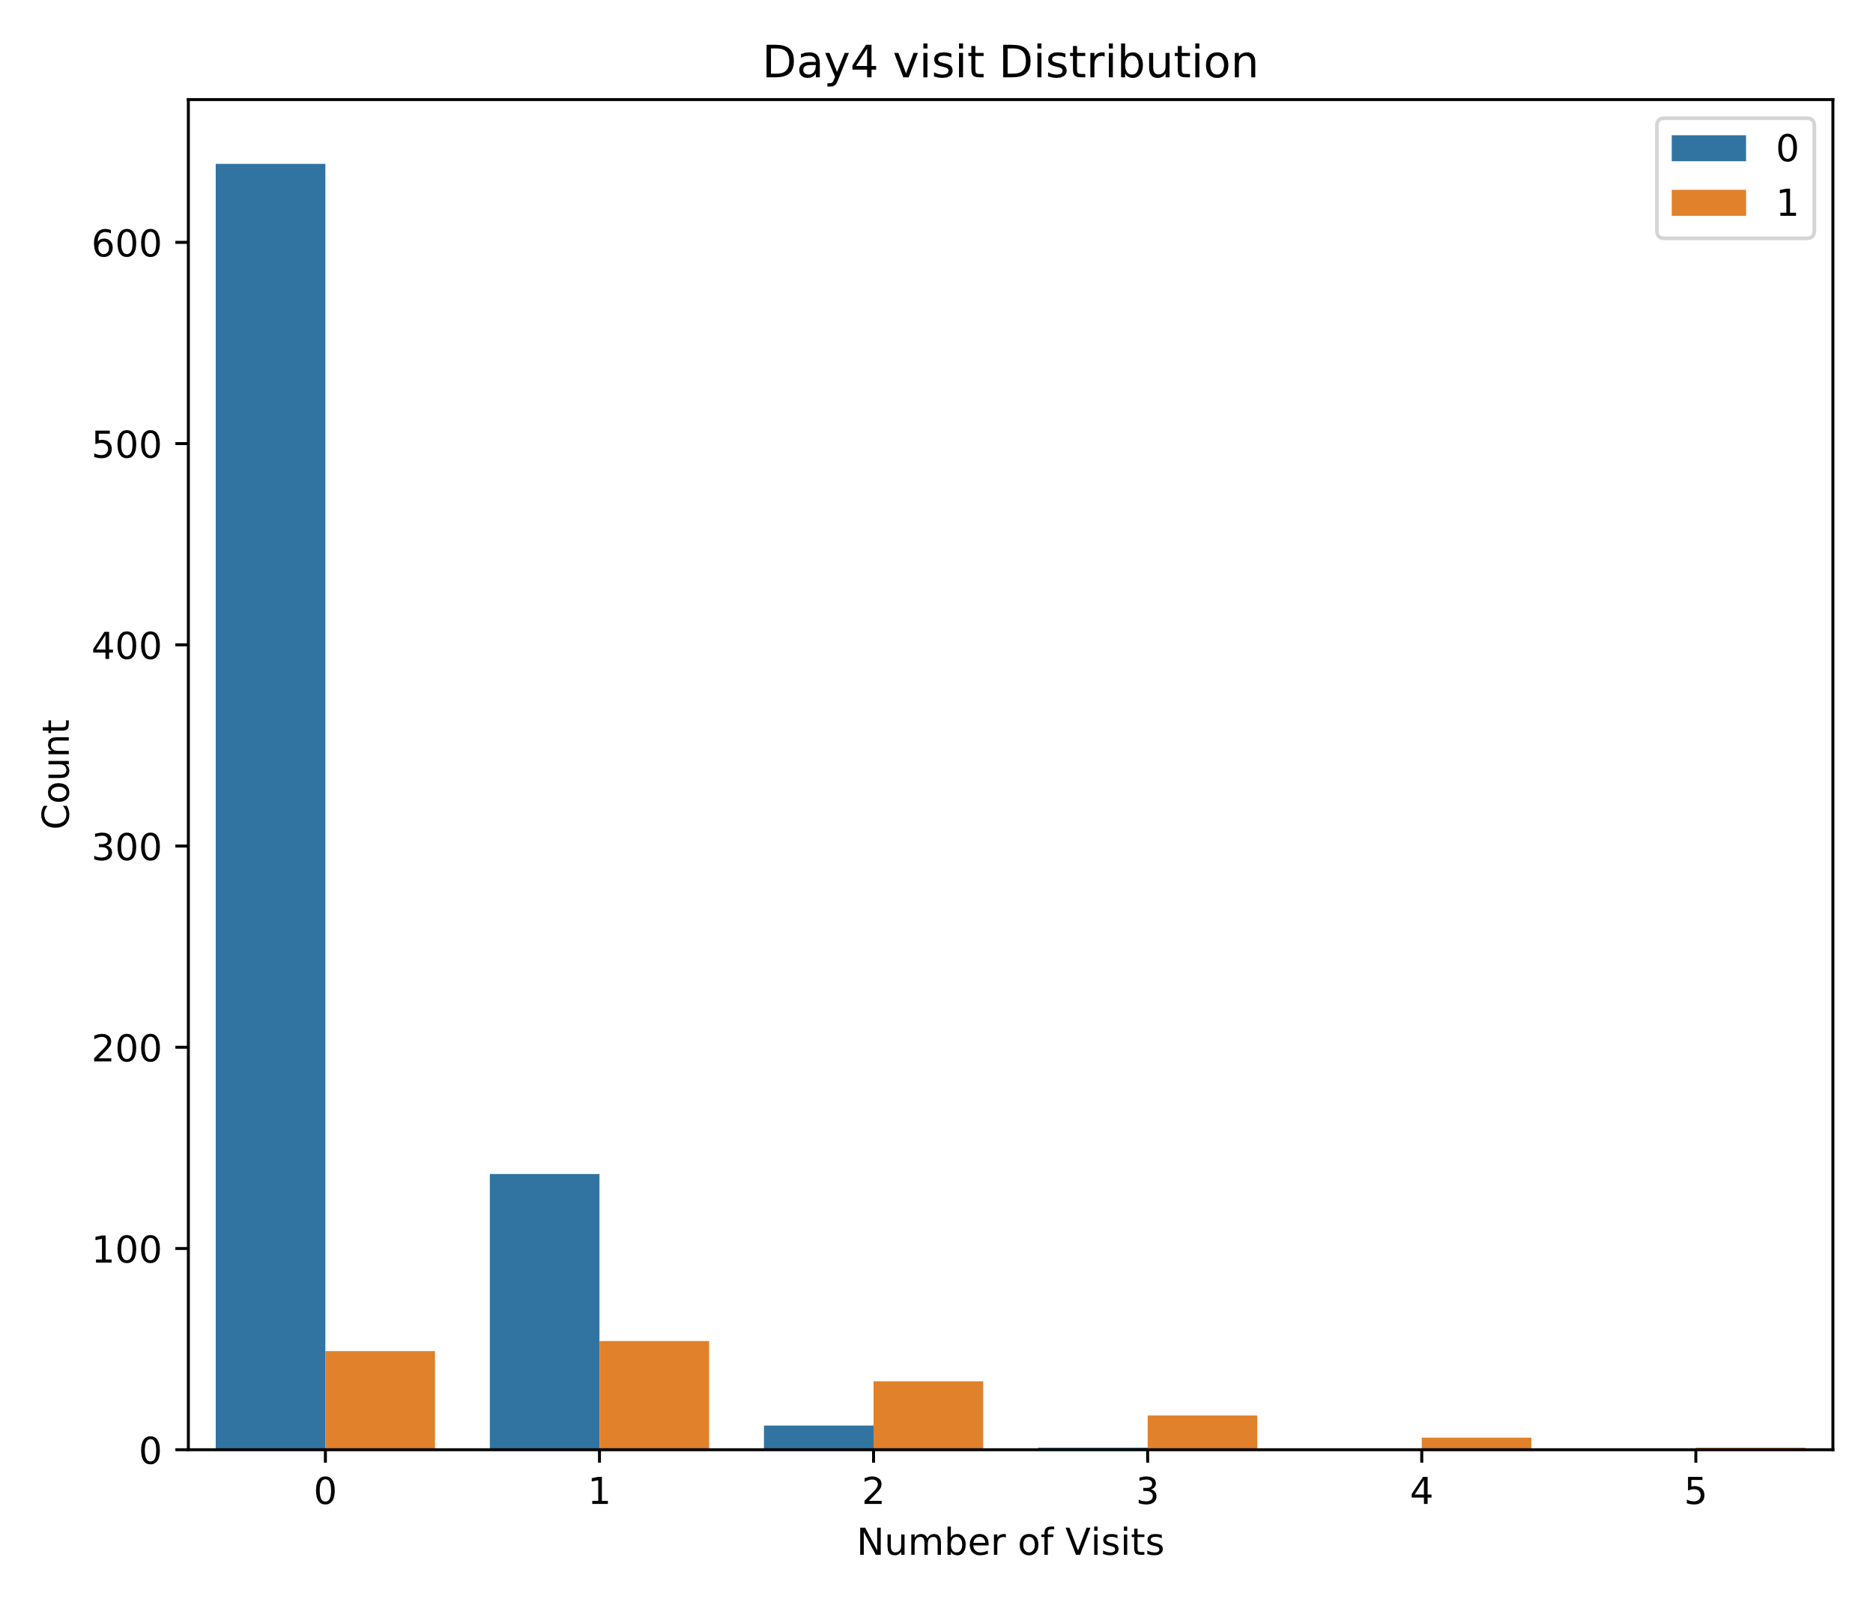
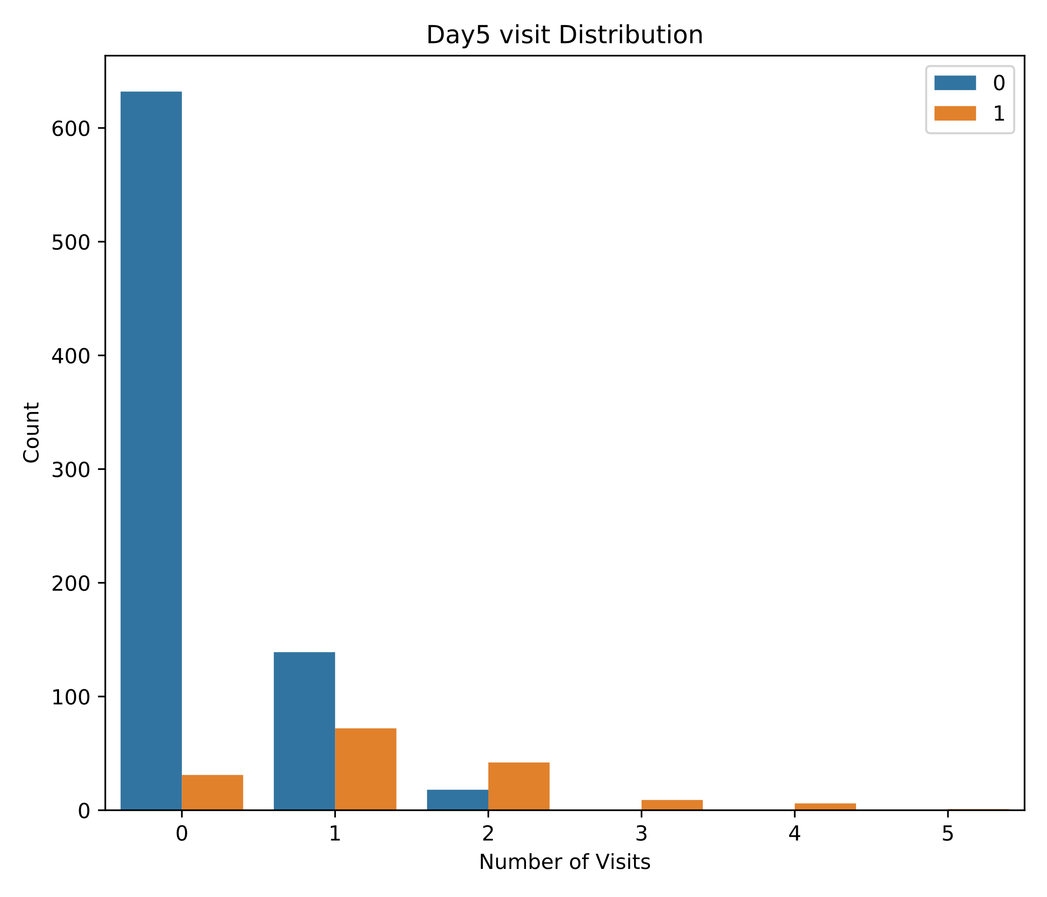
Research Questions (Contd.)

Slide 6
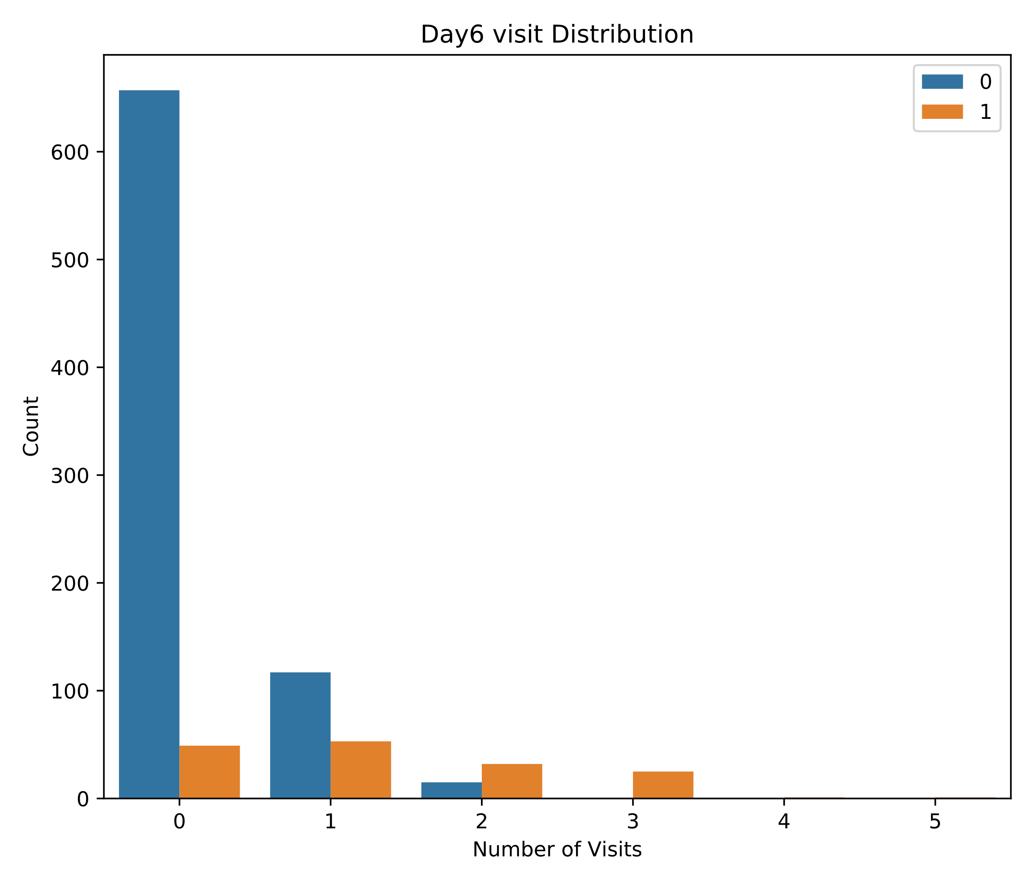
Research Questions (Contd.)
Customers who subscribed after trial period
Customers who didn’t subscribe after trial period
It can be deciphered from the plots of seven days that the customers who visit often (3-5 times) are likely to subscribe. The same can be confirmed from the above tables.
A feedback form can be sent to customers who visit less often (from day_0 to day_2) after 3 days of trial period through email asking what do they think about the services/system and how it can be improved, whether they are considering to subscribe, if not, why.
Note: Analysing through this method is not feasible (it’s hard to plot 20 graphs and interpret) especially when we need to consider longer histories, for instance 20 days instead of 7 days).
In that case, we can analyse through 3D graph method.

Slide 7
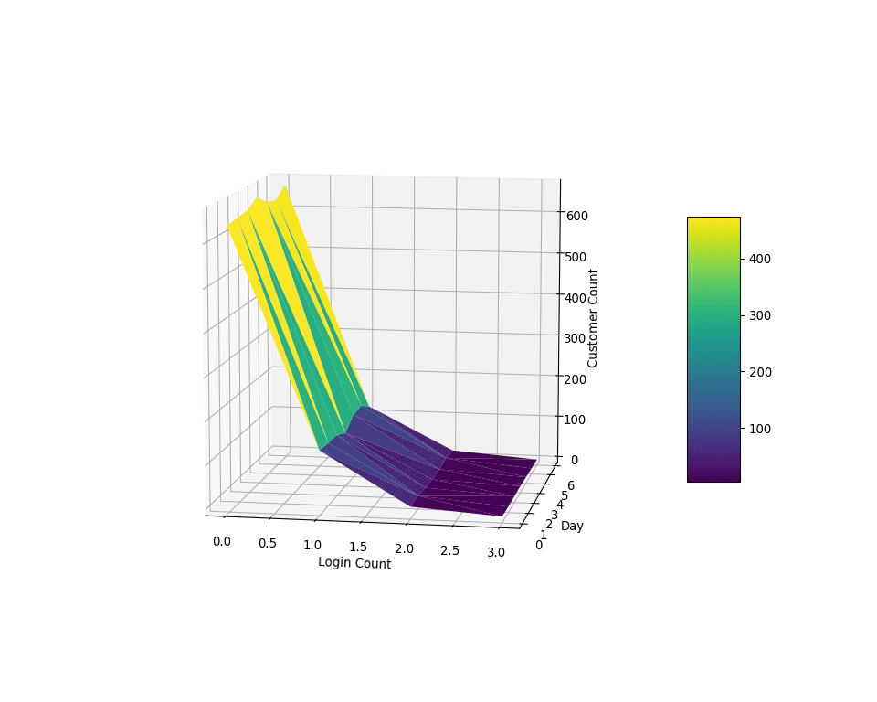
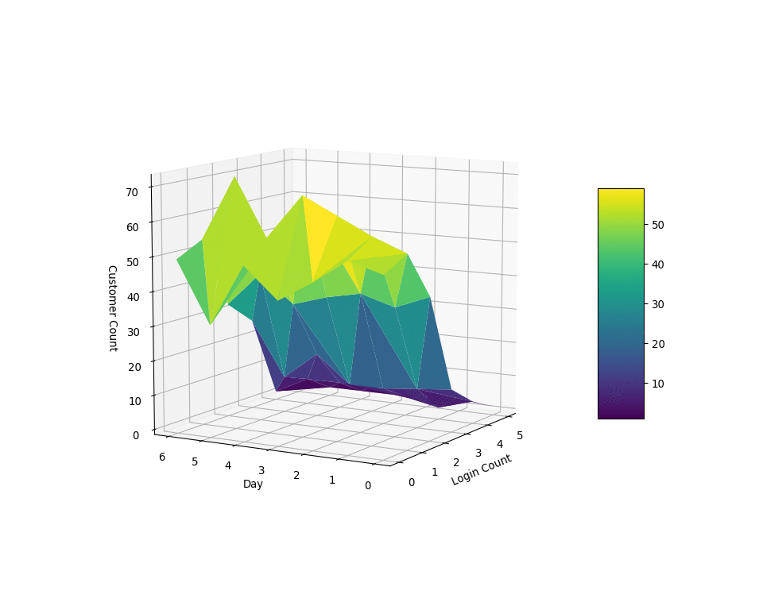
Research Questions (Contd.)
3D graph method:
The same can be observed in the below plots. This is more feasible in case if we need to deal with long histories.
It is interesting to mention that, in the case of customers who “didn’t subscribe” there are many customers who haven’t logged in. It might be the same customers who haven’t logged in for 7 days or might be a new set of customers every day. In order to visualise this, Cohort analysis can be leveraged. This is wasn’t implemented here due to my pressed schedule.
Customers who subscribed after trial period
Customers who didn’t subscribe after trial period

Slide 8
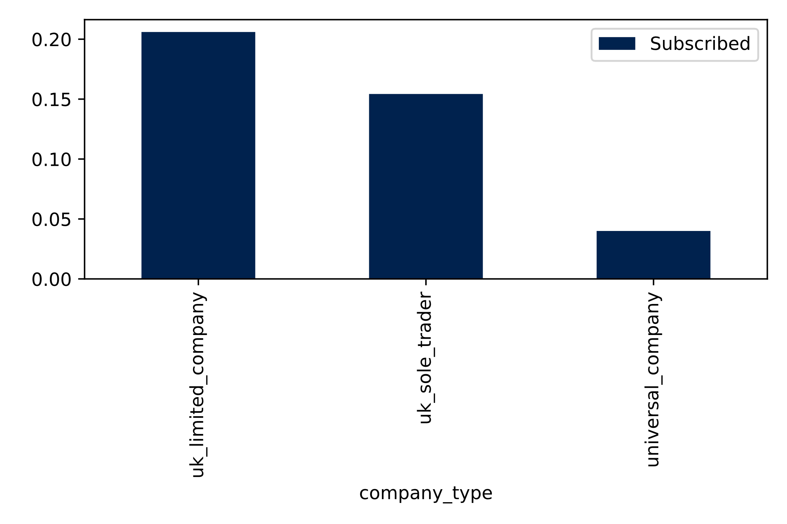
Research Questions (Contd.)
3. There are three company types. Does any company type customers more likely to subscribe?
From the plot on the right side, it can be seen that 20% of “uk_limited_company” followed by around 15% of “uk_sole_trader” which is followed by around 4-5% of “universal_company” subscribed after the trial period.
It has to be investigated why only 4-5% of “universal_company” subscribed.
Was there any well known company providing the same/similar services at a lower cost in an another country?
What went wrong with the 80% of “uk_limited_company” who didn’t subscribe?
Was the pricing too high? Did they face regular technical glitches?
As mentioned before, feedback forms can be sent to these firms after the 7 day trial period if they haven’t subscribed in order to improve the services.

Slide 9
Prediction

Slide 10
Preprocessing for Prediction
The rows from "company_log.csv“ were shuffled randomly.
The rows were then split into 75% of data as training data, 15% of data as validation data and 10% of data as test data
The training, validation and test data were stratified inorder to maintain the class ratio to avoid class imbalance
The features of training data were then standardised (zero mean and unit variance) and then the validation and test data were transformed using the transformation scale from the training data. Standardization is not necessary for our dataset as all the features are in the same unit

Slide 11
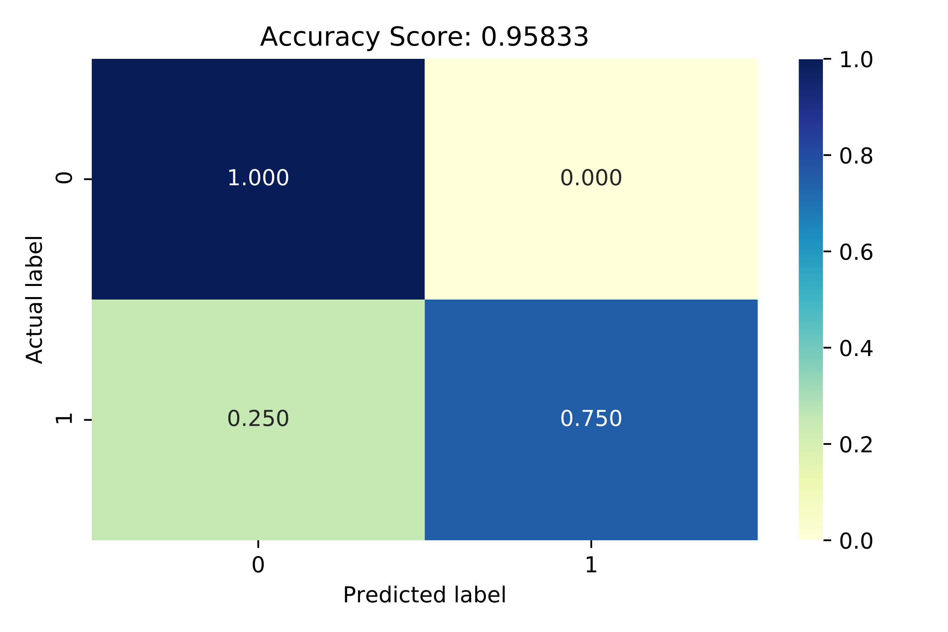
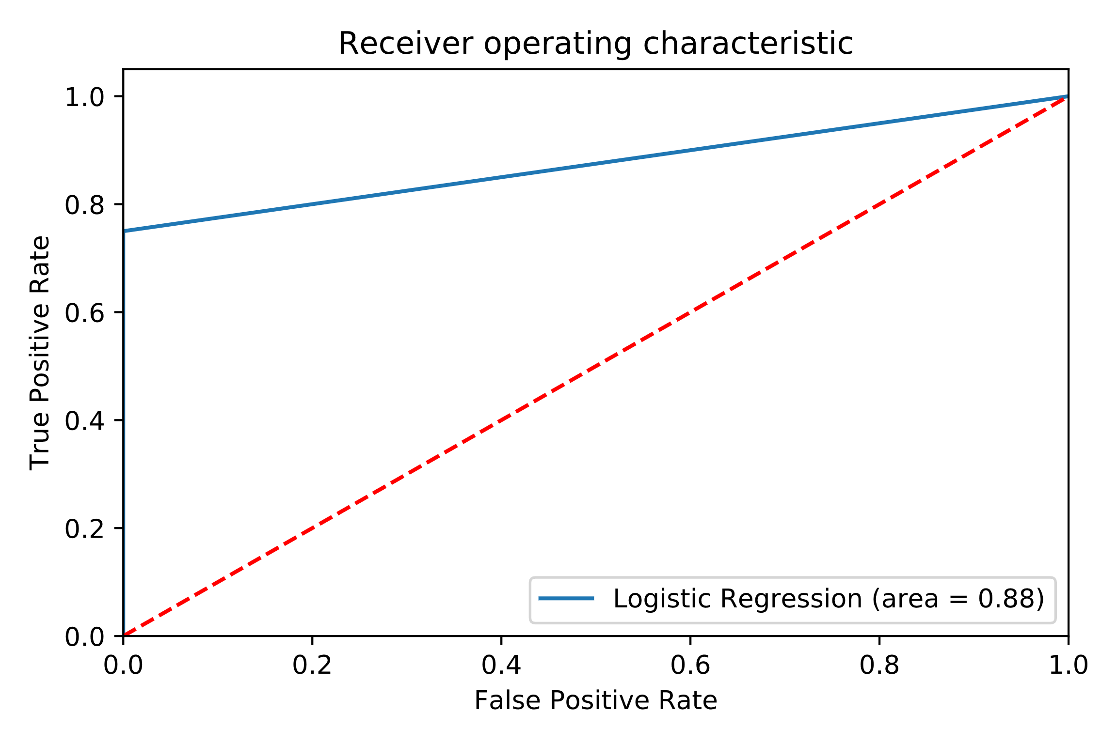
Logistic Regression
Logistic Regression was initially leveraged as they are computationally fast (depends on the optimiser) compared to other methods and not memory hungry unlike neural networks.
Limited-memory Broyden–Fletcher–Goldfarb–Shanno (LBFGS) algorithm (Fast and efficient) was used for optimizing the loss function.
The accuracies obtained on the validation and test data are 98.59% and 95.83% respectively.
It is interesting to see that we obtain 100% True Negatives.
The Receiver operating characteristic (ROC) curve is well away from the random classifier, implies the classifier is doing a pretty good job.

Slide 12
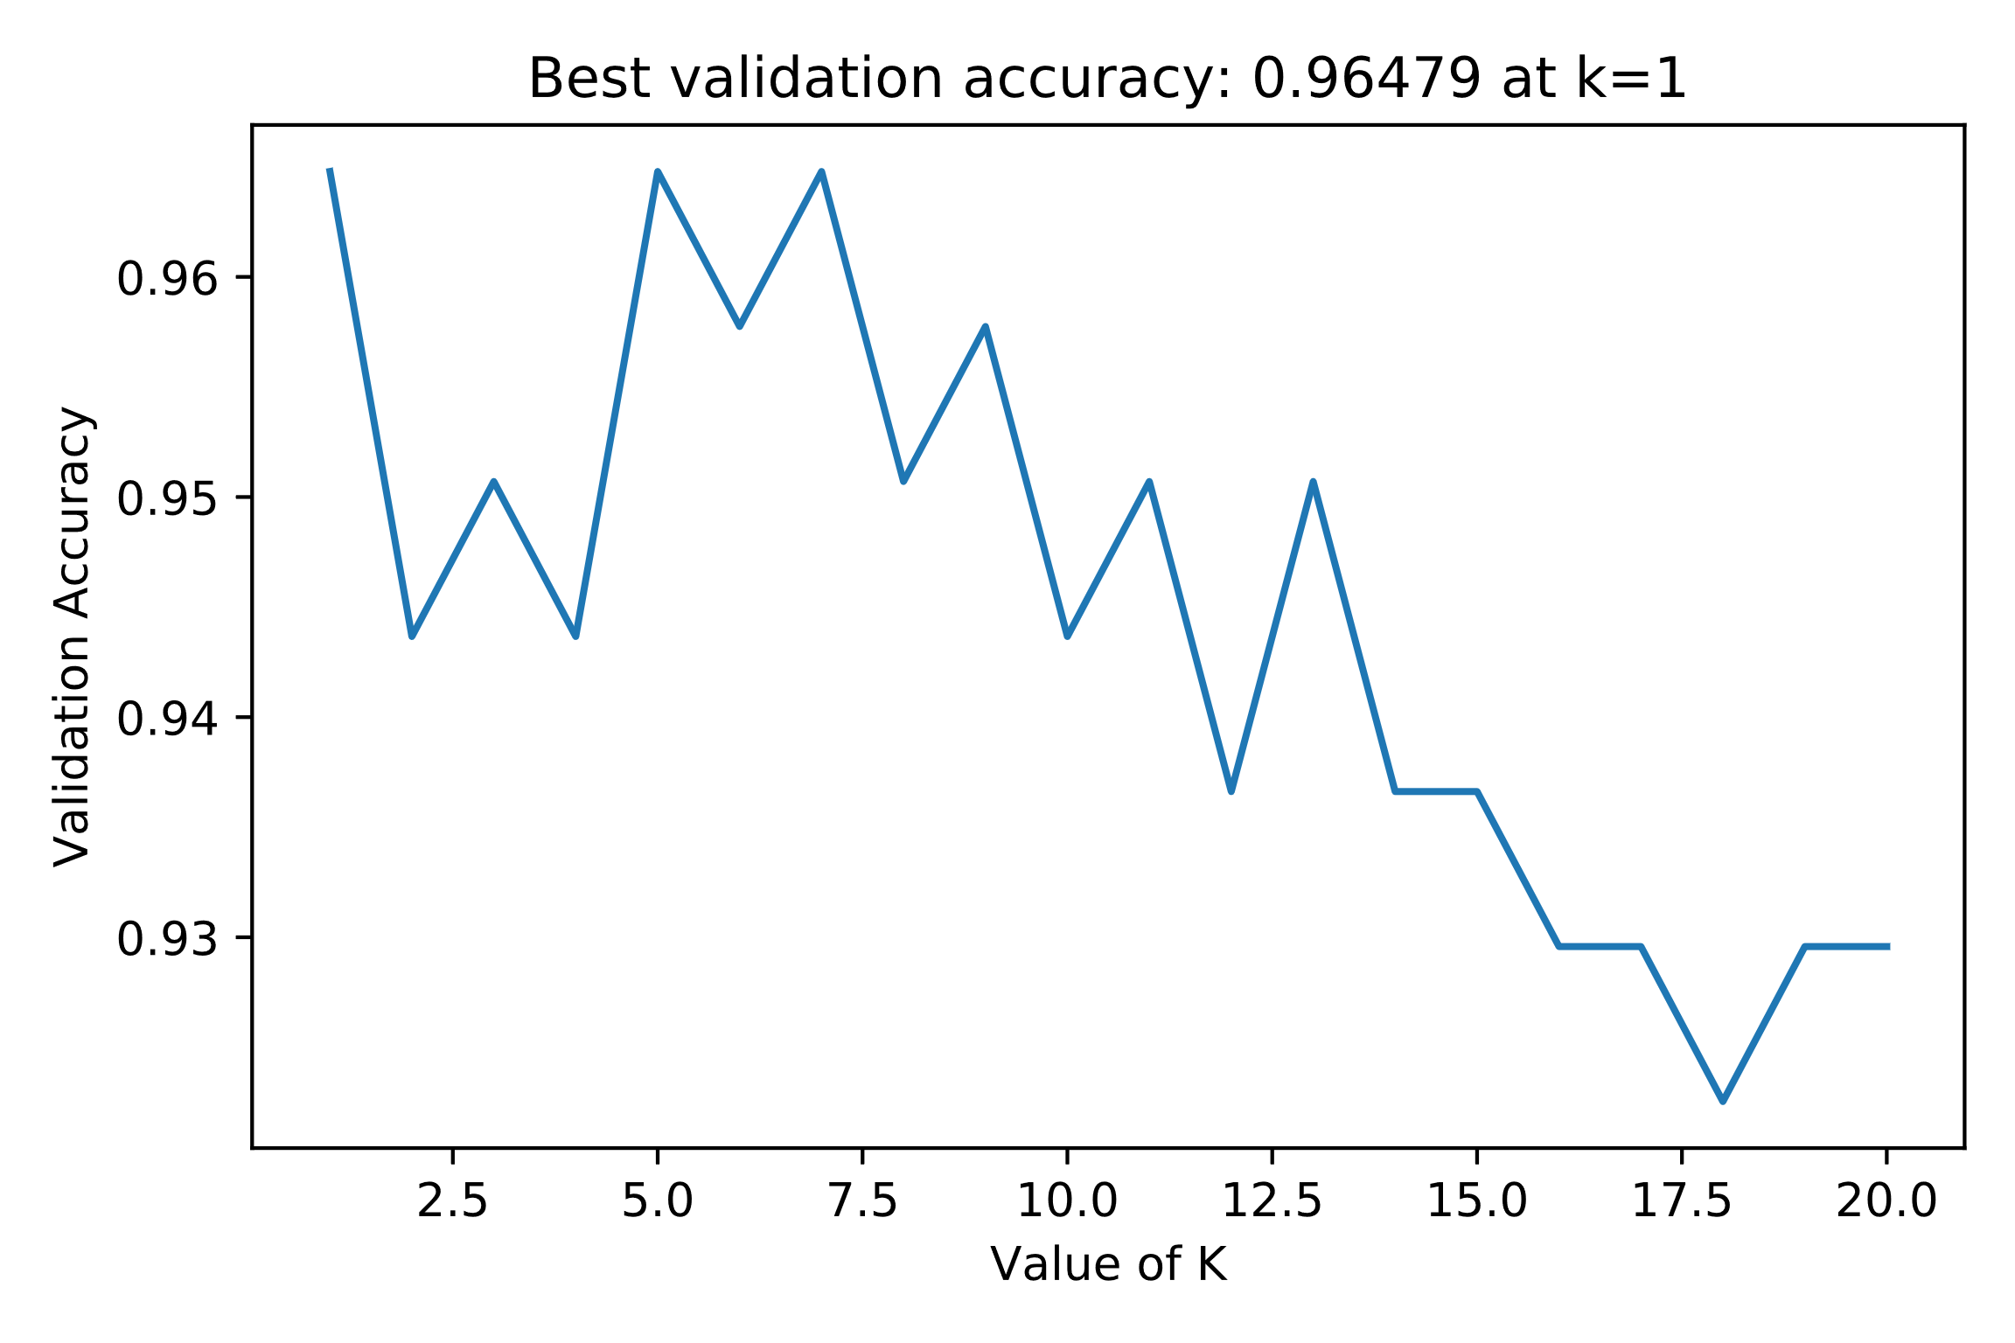
K-NN, Gaussian Process and Neural Network
K-NN
With the help of validation set, #of neighbours (k) was found to be 1.
The accuracy obtained on the test data with k=1 is 91.67%
Gaussian Process
RBF kernel was leveraged.
The accuracy obtained on the test data is 95.83%
Neural Network
Optimal hidden units and layers were found using grid search on validation set and found to be 10 units on each of the 2 hidden layers.
The accuracy obtained on the test data is 96.88%
The accuracy is best for the Neural network. But considering memory, time taken and comparable accuracy, Logistic Regression is the winner for this task.
Search for ‘k’
Area under the curve of Receiver operating characteristic (ROC) is not considered here for comparison because we are not dealing with medical data where the false negatives, false positives matter.
So, here we are just interested in the accuracy.

